Slide 1
Parallelizing the Path Tracing Algorithm
NYCU PP-f22 Final Project
Group 17
0816117 許凱傑 0716021 張家豪 0816152 林栢瑋

Slide 2
Outline
Introduction to Path Tracing
The Path Tracing Algorithm
Parallelizing Path Tracing
Experiment Results and Analysis
Conclusion

Slide 3
1.
Path Tracing
What’s Path Tracing and why is it used?

Slide 4
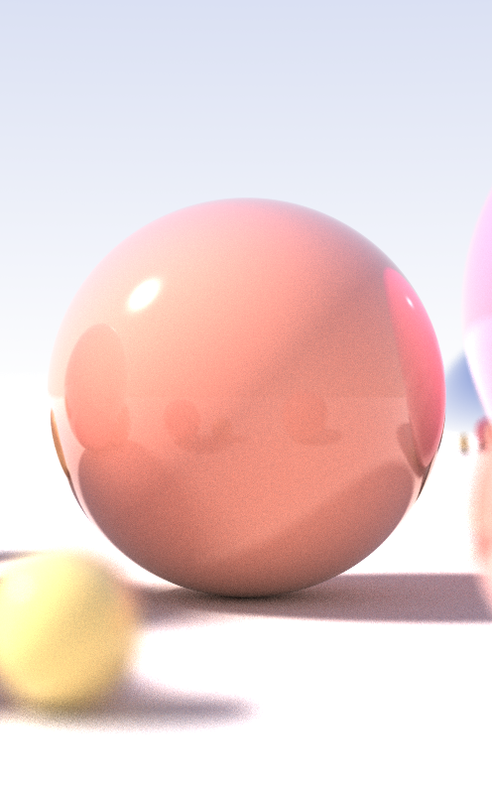
Ray Tracing
A technique to generate photorealistic 3D images
It uses a pixel-based rendering approach to model light transport
Can simulate optical effects such as reflection, refraction, soft shadows, scattering, etc.
Notes:
在介紹 path tracing 之間，我們先來認識一下一個更為廣泛的名詞，Ray tracing。
Ray tracing 與以往計算機圖學當中以物體為主的渲染方式不同，
是透過模擬光在空間行進中的軌跡，並打在各種不同材質物體上進行折射、反射、散射，最終形成圖像的結果
透過這種方式渲染而成的圖片可以做到非常逼真的效果

Slide 5
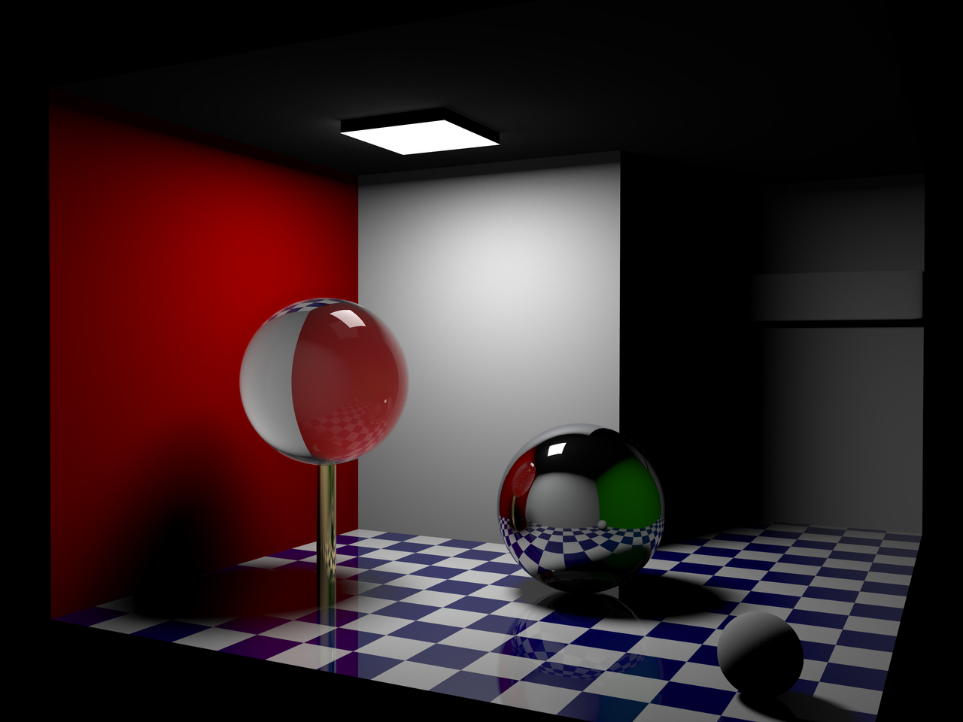
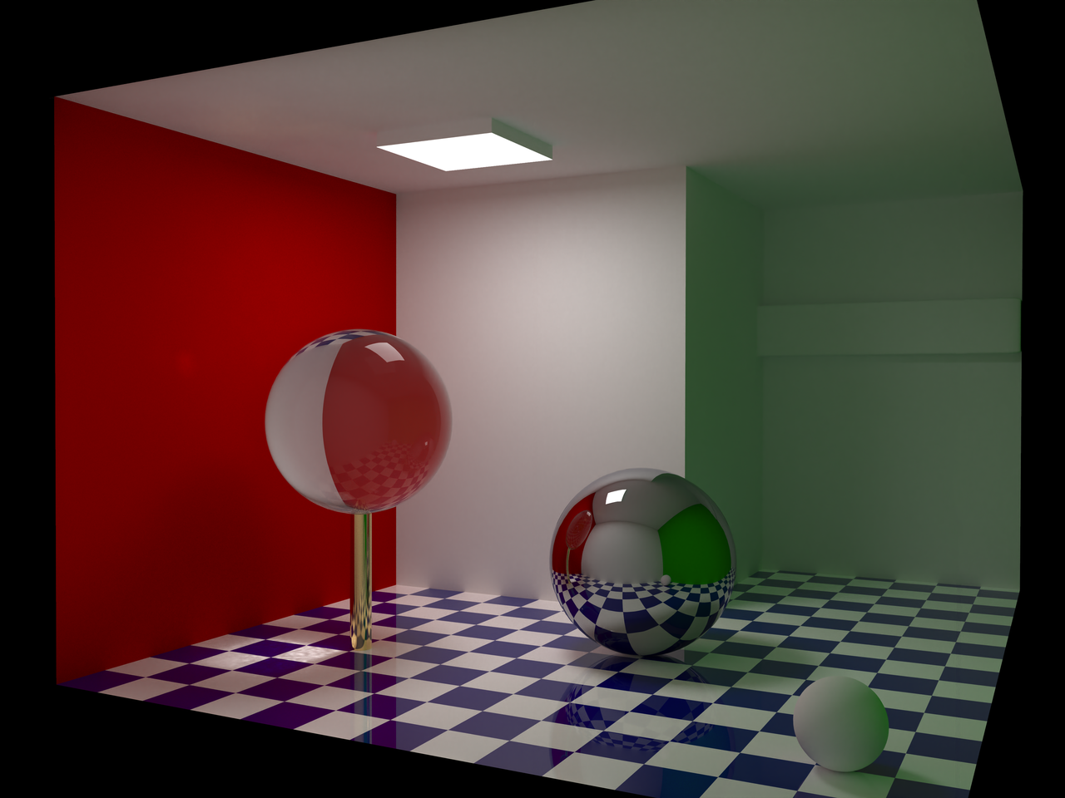
Ray Tracing
Deals with global illumination
Path tracing is one of the most common ray tracing techniques
Notes:
Ray Tracing 也能處理 Global illumination 的問題
被其他物體反射的光打亮的狀況，可以看綠色的牆會造成整區都是綠的。
接著就會交替使用這些名詞.

Slide 6


Path Tracing Examples
Largely used in films and games
Very realistic, but computationally expensive to simulate light
We would like to accelerate it by using methods learned in class
Notes:
https://docs.unrealengine.com/4.27/en-US/RenderingAndGraphics/RayTracing/PathTracer/
https://github.com/vkoskiv/c-ray
這兩個都是很好的 ray tracing or path tracing 例子
他們很真實，但由於要模擬光線的路徑，因此計算要花非常久的時間。
我們想利用

Slide 7
2.
Path Tracing:
A dive into the algorithm
How path tracing works, and why speeding it up

Slide 8
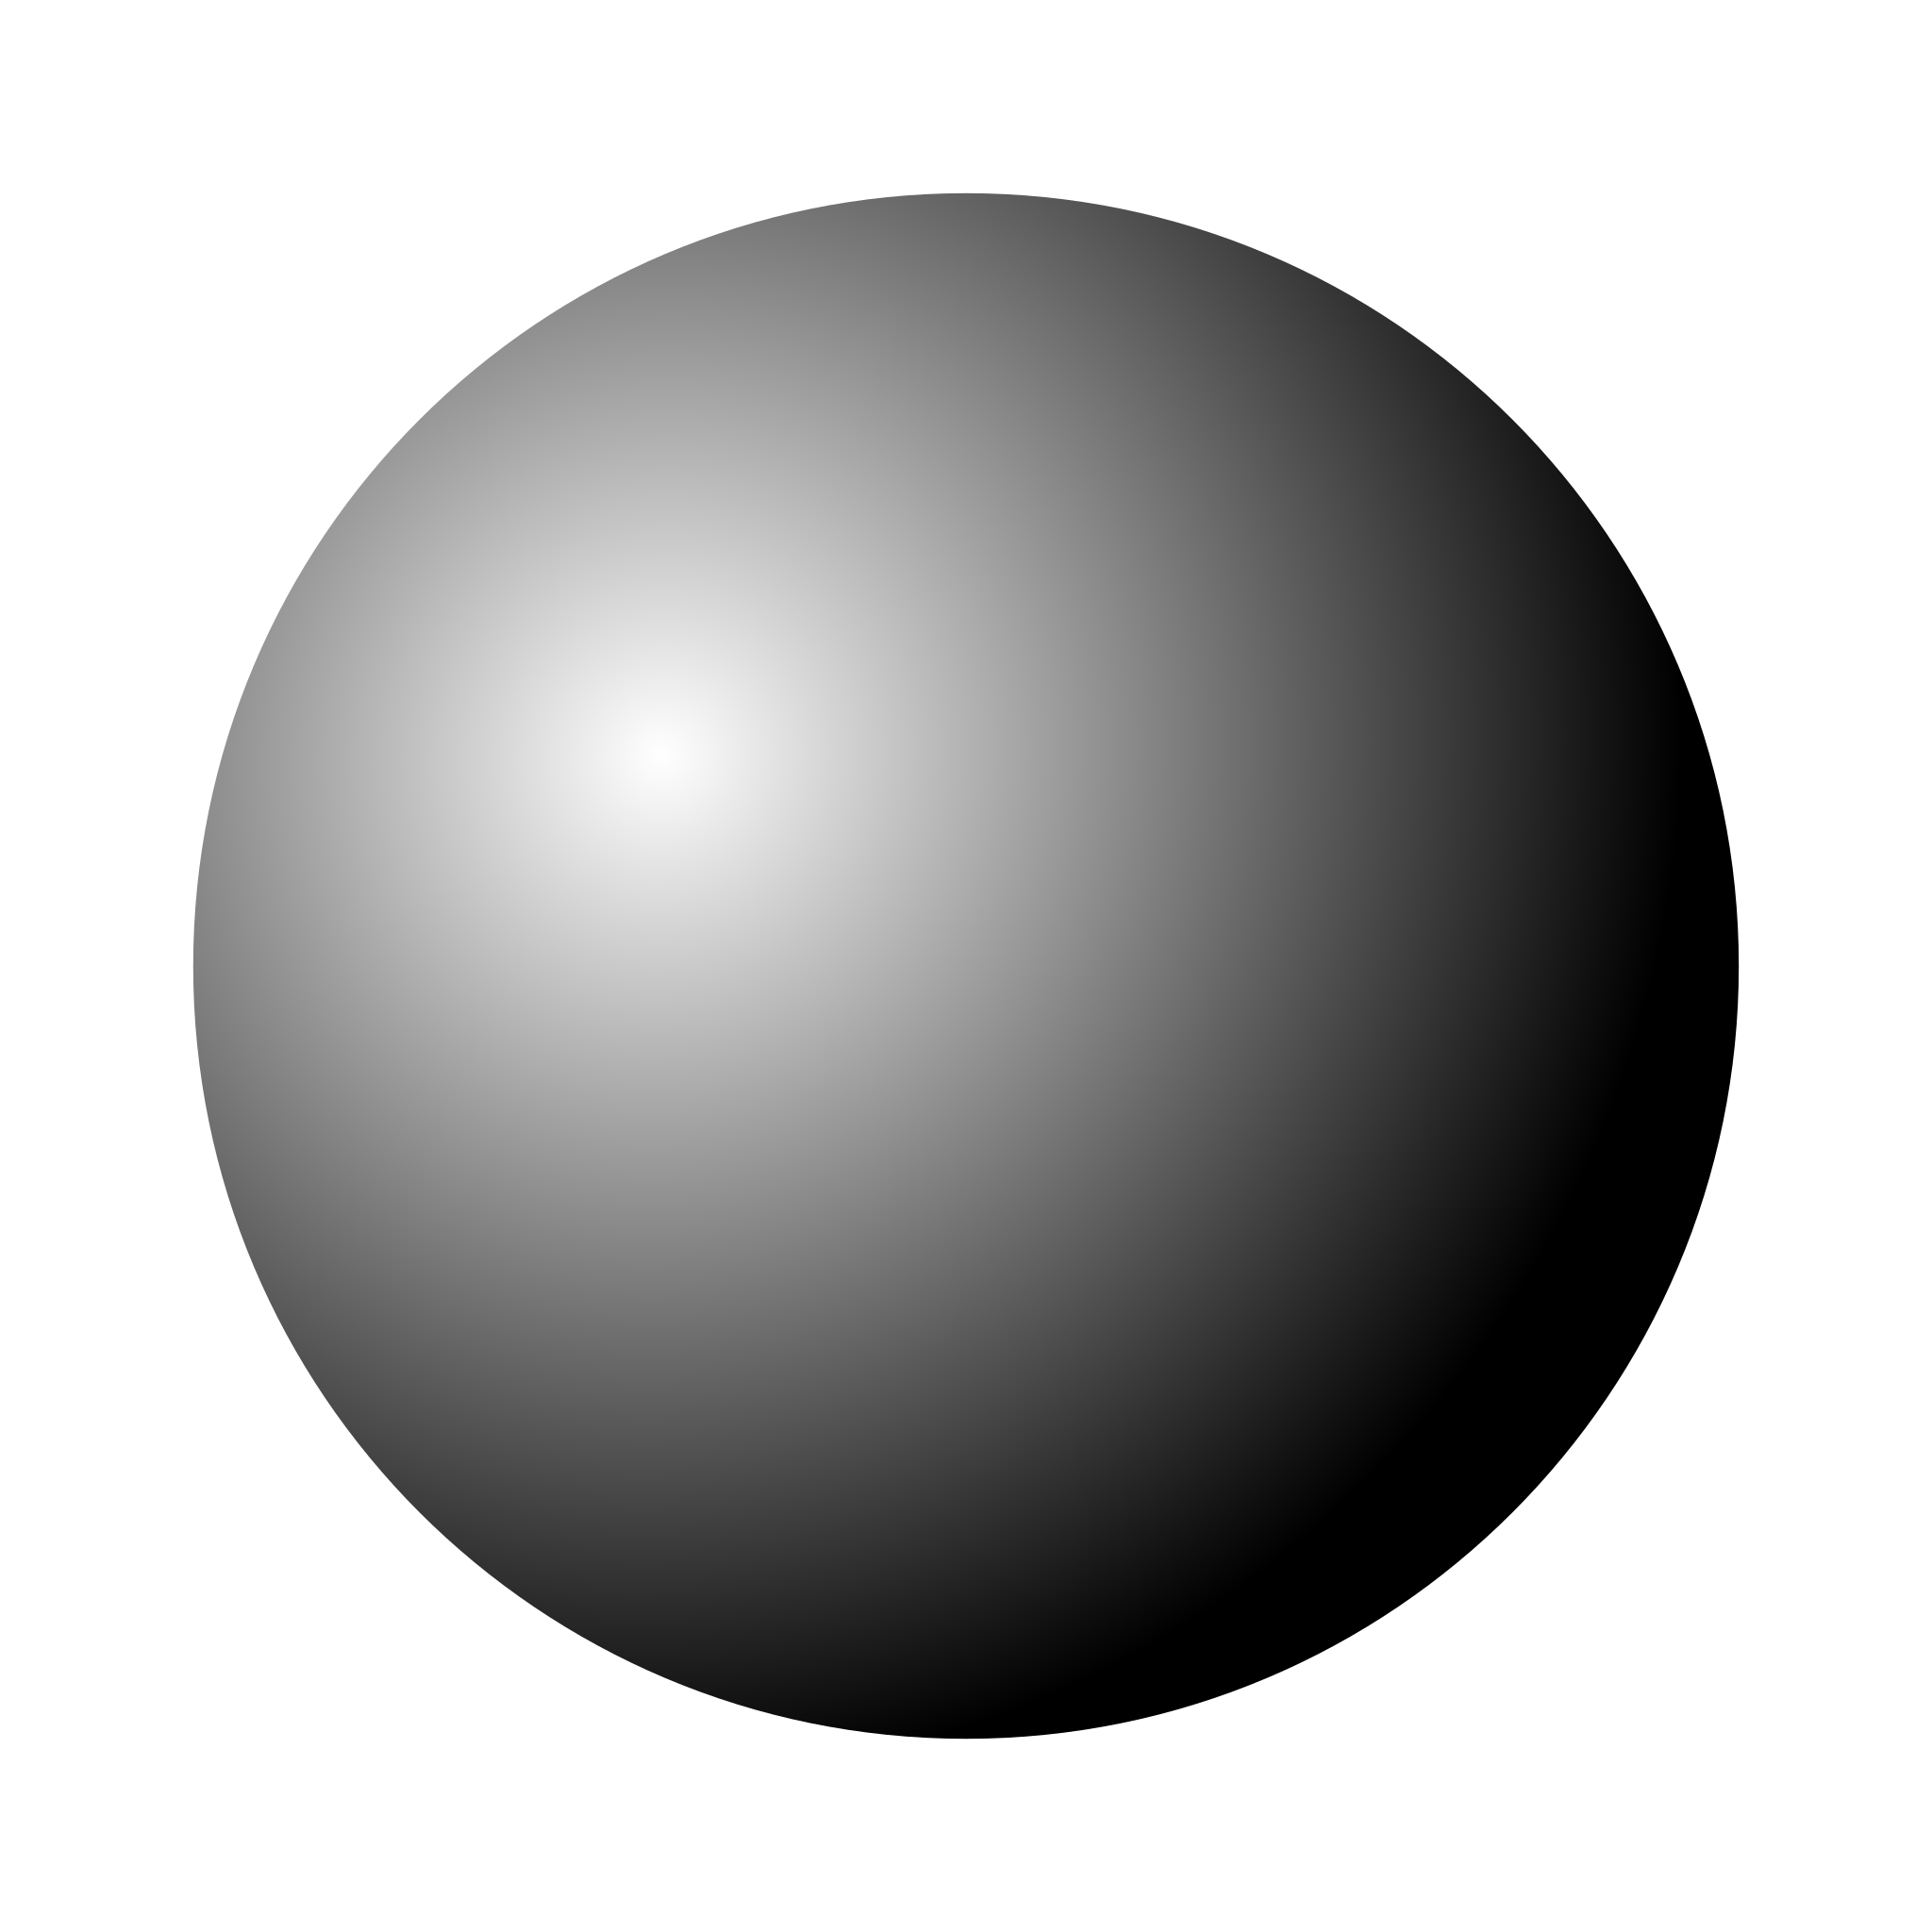
The Physics of Light
Notes:
在了解路徑追蹤

Slide 9
The Physics of Light

Slide 10
The Physics of Light

Slide 11
The Physics of Light
We can see this object
because of the reflection

Slide 12
The Physics of Light

Slide 13
The Physics of Light
Notes:
我們只要能夠去模擬所有環境中的光線就好了呀! 就可以做到超逼真的圖像渲染了!

Slide 14
The Physics of Light
Obviously,
there will be rays that
don’t reach the eye

Slide 15
Path Tracing

Slide 16
Path Tracing
1. For each pixel

Slide 17
Path Tracing
1. For each pixel
2. Generate a ray that points towards the pixel

Slide 18
Path Tracing
1. For each pixel
2. Generate a ray that points towards the pixel
3. Find the first object that the ray intersects with

Slide 19
Path Tracing
1. For each pixel
2. Generate a ray that points towards the pixel
3. Find the first object that the ray intersects with
4. Accumulate the color, randomly
pick a direction to generate a new ray

Slide 20
Path Tracing
1. For each pixel
2. Generate a ray that points towards the pixel
3. Find the first object that the ray intersects with
4. Accumulate the color, randomly
pick a direction to generate a new ray
5. Repeat steps 3,4 until maximum depth reached or light source reached

Slide 21
Path Tracing
1. For each pixel
2. Generate a ray that points towards the pixel
3. Find the first object that the ray intersects with
4. Accumulate the color, randomly
pick a direction to generate a new ray
5. Repeat steps 3,4 until maximum depth reached or light source reached

Slide 22
Path Tracing
1. For each pixel
2. Generate a ray that points towards the pixel
3. Find the first object that the ray intersects with
4. Accumulate the color, randomly
pick a direction to generate a new ray
5. Repeat steps 3,4 until maximum depth reached or light source reached
x # of samples
Pixel color=
All samples averaged
Notes:
顯然，如果一個pixel只採樣一到射線的話，光線會比較

Slide 23
Path Tracing
For each pixel
1. For each pixel
2. Generate a ray that points towards the pixel
3. Find the first object that the ray intersects with
4. Accumulate the color, randomly
pick a direction to generate a new ray
5. Repeat steps 3,4 until maximum depth reached or light source reached

Slide 24
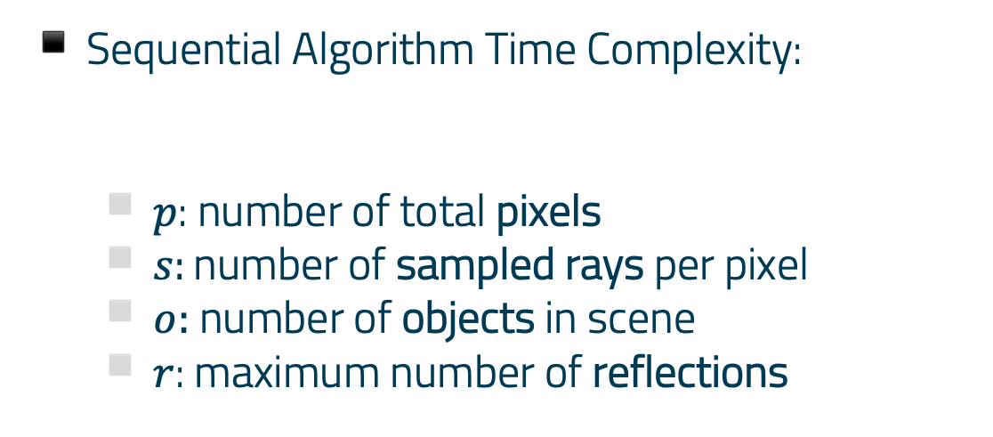
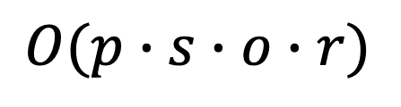
Path Tracing
Sequential Algorithm Time Complexity:
$p$: number of total pixels
$s$: number of sampled rays per pixel
$o:$ number of objects in scene
$r$: maximum number of reflections
$$O(p∙s∙o∙r)$$
Notes:
不同的 pixel 要做的事情分給不同 thread 執行
每個

Slide 25
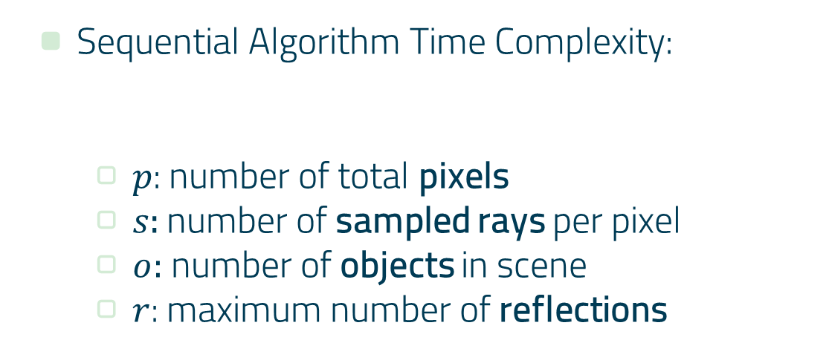
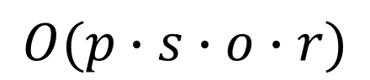
Path Tracing
Sequential Algorithm Time Complexity:
$p$: number of total pixels
$s$: number of sampled rays per pixel
$o:$ number of objects in scene
$r$: maximum number of reflections
$$O(p∙s∙o∙r)$$
CAN BE PARALLELIZED!

Slide 26
3. Parallelizing
The Path Tracing Algorithm
Make it faster!!

Slide 27
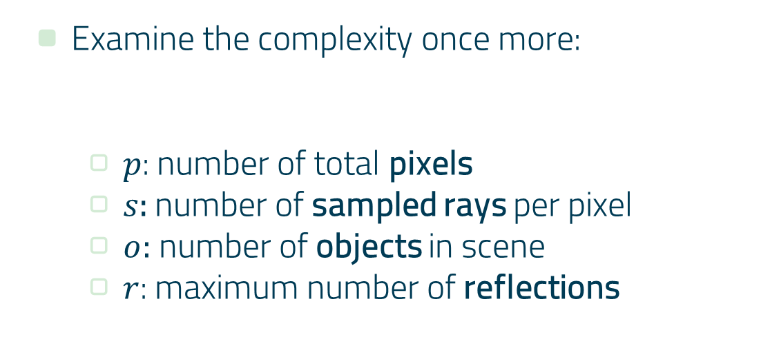
Parallelizing Path Tracing
Examine the complexity once more:
$p$: number of total pixels
$s$: number of sampled rays per pixel
$o:$ number of objects in scene
$r$: maximum number of reflections
$$O(p∙s∙o∙r)$$
Notes:
將畫面分割，將 pixel 分給不同的 thread 運算

Slide 28
Parallelizing Path Tracing
Examine the complexity once more:
$p$: number of total pixels
$s$: number of sampled rays per pixel
$o:$ number of objects in scene
$r$: maximum number of reflections
$$O(p∙s∙o∙r)$$
Notes:
R: 由於每一次反射會與前一次的結果相依，因此他是沒有辦法做平行的
O: 偵測每個物體誰最先被碰到，由於每一類別的物體計算碰撞的時間不同，且要找到這之中距離最近的會須要很大的overhead，所以我們認為也不利於做平行化，
因此我們決定不做這方面的

Slide 29
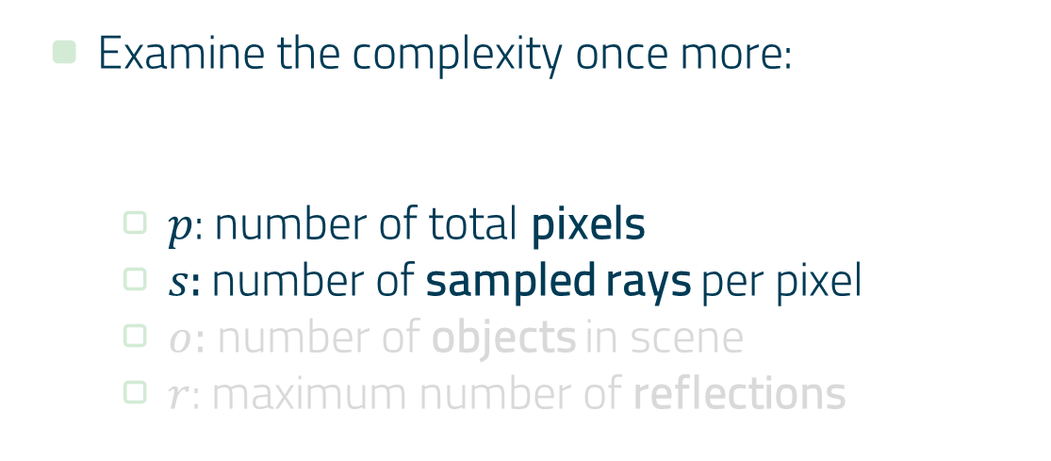
Parallelizing Path Tracing
Examine the complexity once more:
$p$: number of total pixels
$s$: number of sampled rays per pixel
$o:$ number of objects in scene
$r$: maximum number of reflections
$$O(p∙s∙o∙r)$$

Slide 30
Parallelizing Path Tracing
Examine the complexity once more:
$p$: number of total pixels
$s$: number of sampled rays per pixel
$o:$ number of objects in scene
$r$: maximum number of reflections
$$O(p∙s∙o∙r)$$
Which to parallelize?

Slide 31
Implementation and Analysis
Programming and Analyzing

Slide 32

Implementing a Serial Ray Tracer
Implementation Language: C++
Build a ray tracer from scratch following the book
Parallelization methods:
Multithreading (OpenMP)
CUDA

Slide 33
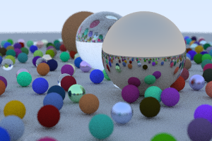
Render a simple image
Setting:
Object: 486 spheres
Pixels: 300 x 200
Samples: 50
Max reflection depth: 50

Slide 34
Parallelize Pixels or Sample Rays?
Use OpenMP to perform parallelization, speedup:
Threads | 2 | 4 | 8
Pixel-wise Parallel | 1.53x | 2.63x | 3.25x
Ray-wise Parallel | 1.72x | 2.71x | 2.44x
Notes:
Ray 分配不平均

Slide 35
Parallelize Pixels or Sample Rays?
Use OpenMP to perform parallelization
Threads | 2 | 4 | 8
Pixel-wise Parallel | 1.53x | 2.63x | 3.25x
Ray-wise Parallel | 1.72x | 2.71x | 2.44x
Synchronization overhead
Notes:
Ray 分配不平均

Slide 36
Parallelize Pixels or Sample Rays?
We decided to parallelize each pixel (pixels distributed)
Parallelize with OpenMP
Parallelize with CUDA
Compare the results
Notes:
Ray 分配不平均

Slide 37
Experiment Settings, Results, and Analysis
Programming and Analyzing

Slide 38
Experimental Setting
Compare 3 Methods:
Serial
CPU Multithreading (OpenMP)
8 Threads
Cuda
Grid size 8x8
Block size 8x8
Parallelize serial by distributing pixels
Notes:
Ray 分配不平均

Slide 39
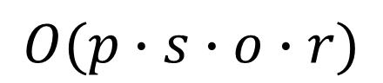
Experimental Setting
4 settings:
Image size (number of pixels)
Ray samples per pixel
Maximum reflection depth
Different scenes
Analyze the performance of the methods under different settings
$$O(p∙s∙o∙r)$$
Notes:
Ray 分配不平均

Slide 40
Experimental Setting
Performance metric
Execution time of parallelized section
Speedup relative to serial implementation
Notes:
Ray 分配不平均

Slide 41
Platform and Implementation Details
OS: Ubuntu 20.04.5 LTS CPU: AMD® Ryzen 7 3750h with radeon vega mobile gfx × 8 GPU: GeForce GTX 1650 Mobile / Max-Q MEM: 15.4 GiB
Notes:
Ray 分配不平均

Slide 42
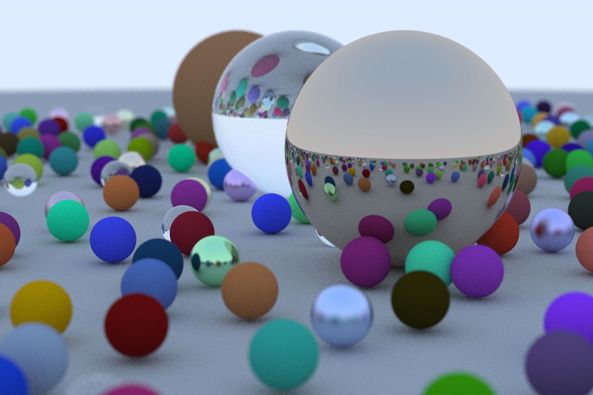
1. Image Size
Setting 1: Modify Number of Pixels
Samples per pixel: 50
Max reflection depth: 50
Three image sizes:
300x200
600x400
1200x800
Notes:
Ray 分配不平均

Slide 43
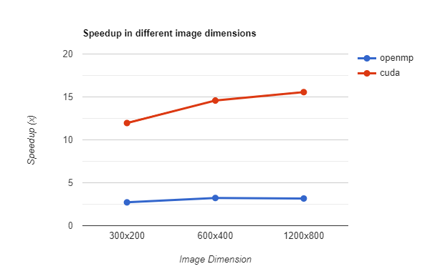
1. Image Size
Size | 300x200 |  | 600x400 |  | 1200x800
- | Time | Speedup | Time | speedup | Time | Speedup
serial | 17.7s | 1.0x | 70.42s | 1.0x | 285.28s | 1.0x
multi-thread | 6.50s | 2.72x | 21.77s | 3.23x | 90.1s | 3.17x
cuda | 1.48s | 11.96x | 4.83s | 14.58x | 18.33s | 15.56x
Notes:
Ray 分配不平均

Slide 44
1. Image Size
As the image size increases, the speedup by GPU becomes even more efficient
Size | 300x200 |  | 600x400 |  | 1200x800
- | Time | Speedup | Time | speedup | Time | Speedup
serial | 17.7s | 1.0x | 70.42s | 1.0x | 285.28s | 1.0x
multi-thread | 6.50s | 2.72x | 21.77s | 3.23x | 90.1s | 3.17x
cuda | 1.48s | 11.96x | 4.83s | 14.58x | 18.33s | 15.56x
Notes:
以 GPU 來說，越多(像速點)資料GPU的加速更顯著
鄰近的 pixel 反彈的位置會比較類似，GPU 一個 warp 的時間會差不多

Slide 45



2. Ray Samples per Pixels
Setting 2: Ray samples per pixels
Image size: 600x400
Max reflection depth: 50
Three different sample rates:
10
50
200
Notes:
對於每個像素點要採樣的 ray 次數

Slide 46
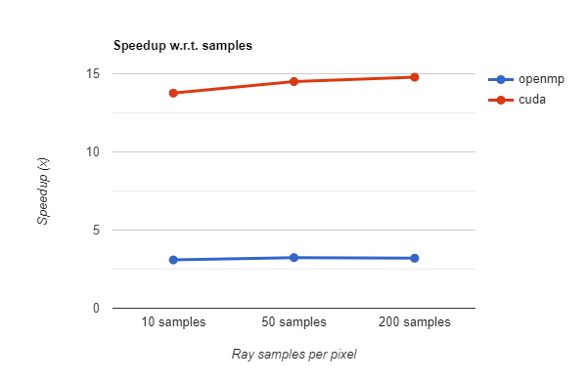
2. Ray Samples per Pixel
We’re both adding computations
Samples | 10 samples |  | 50 samples |  | 200 samples
- | Time | Speedup | Time | Speedup | Time | Speedup
serial | 14.17s | 1.0 | 70.33s | 1.0 | 281.75s | 1.0
multithread | 4.58s | 3.09 | 21.71s | 3.24 | 87.92s | 3.2
cuda | 1.03s | 13.76 | 4.85s | 14.5 | 19.06s | 14.78
Notes:
我們這裡的實驗結果會發現，增加像素點與增加單一像素點的採樣次數，speedup 的幅度有一樣的效果
這部分我們推論，因為這些方法增加的計算量對於GPU來說是相同的，因此增長幅度是一樣的

Slide 47
3 Maximum Reflection Depth
Setting 3: Maximum Reflection Depth
Image Size: 600x400
Samples per Pixel: 50
Three maximum reflection depth:
10
25
50
Notes:
Ray 分配不平均

Slide 48
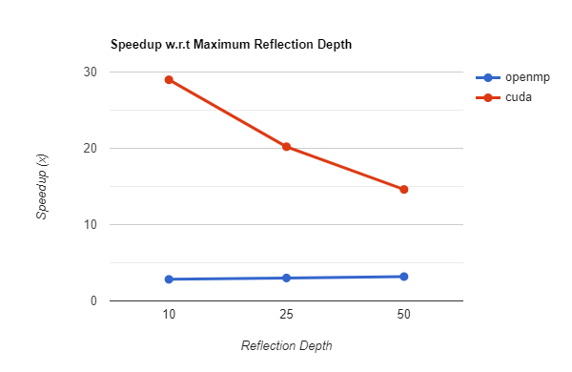
3. Maximum Reflection Depth
max depth | 10 |  | 25 |  | 50
- | Time | Speedup | Time | Speedup | Time | Speedup
serial | 68.97 | 1.0 | 71.30 | 1.0 | 70.72 | 1.0
multithread | 24.37 | 2.83 | 23.69 | 3.01 | 22.17 | 3.19
cuda | 2.38 | 28.98 | 3.53 | 20.21 | 4.84 | 14.61
Notes:
Cuda:
最大反彈次數越低的時候
由於某些 ray 反彈到最大深度，因此結束的時間較晚，以致整個 warp 的執行時間都被拖慢，導致加速的效果不顯著。但如果我們限制最大反彈次數的話，加速就會顯著的上升。
Serial 跟 omp: 他們的速度幾乎沒有變化，我們可以發現這是由於他們沒有 warp ，也就是一組 thread 不會互相影響，因此速度都是差不多的。

Slide 49
3. Maximum Reflection Depth
Per pixel reflection depth
25
50
Notes:
Cuda:
最大反彈次數越低的時候
由於某些 ray 反彈到最大深度，因此結束的時間較晚，以致整個 warp 的執行時間都被拖慢，導致加速的效果不顯著。但如果我們限制最大反彈次數的話，加速就會顯著的上升。
Serial 跟 omp: 他們的速度幾乎沒有變化，我們可以發現這是由於他們沒有 warp ，也就是一組 thread 不會互相影響，因此速度都是差不多的。

Slide 50
3. Maximum Reflection Depth
Per pixel reflection depth
25
50
50
Notes:
Cuda:
最大反彈次數越低的時候
由於某些 ray 反彈到最大深度，因此結束的時間較晚，以致整個 warp 的執行時間都被拖慢，導致加速的效果不顯著。但如果我們限制最大反彈次數的話，加速就會顯著的上升。
Serial 跟 omp: 他們的速度幾乎沒有變化，我們可以發現這是由於他們沒有 warp ，也就是一組 thread 不會互相影響，因此速度都是差不多的。

Slide 51
3. Maximum Reflection Depth
Per pixel reflection depth
10
25
50
50
Notes:
Cuda:
最大反彈次數越低的時候
由於某些 ray 反彈到最大深度，因此結束的時間較晚，以致整個 warp 的執行時間都被拖慢，導致加速的效果不顯著。但如果我們限制最大反彈次數的話，加速就會顯著的上升。
Serial 跟 omp: 他們的速度幾乎沒有變化，我們可以發現這是由於他們沒有 warp ，也就是一組 thread 不會互相影響，因此速度都是差不多的。

Slide 52
3. Maximum Reflection Depth
max depth | 10 |  | 25 |  | 50
- | Time | Speedup | Time | Speedup | Time | Speedup
serial | 68.97 | 1.0 | 71.30 | 1.0 | 70.72 | 1.0
multithread | 24.37 | 2.83 | 23.69 | 3.01 | 22.17 | 3.19
cuda | 2.38 | 28.98 | 3.53 | 20.21 | 4.84 | 14.61
Notes:
Cuda:
最大反彈次數越低的時候
由於某些 ray 反彈到最大深度，因此結束的時間較晚，以致整個 warp 的執行時間都被拖慢，導致加速的效果不顯著。但如果我們限制最大反彈次數的話，加速就會顯著的上升。
Serial 跟 omp: 他們的速度幾乎沒有變化，我們可以發現這是由於他們沒有 warp ，也就是一組 thread 不會互相影響，因此速度都是差不多的。

Slide 53

4 Different Scenes Evaluation
Setting 4: Different Scenes
Image Size: 600x400
Samples per Pixel: 50
Reflection depth: 50
Two different scenes
Notes:
Ray 分配不平均

Slide 54
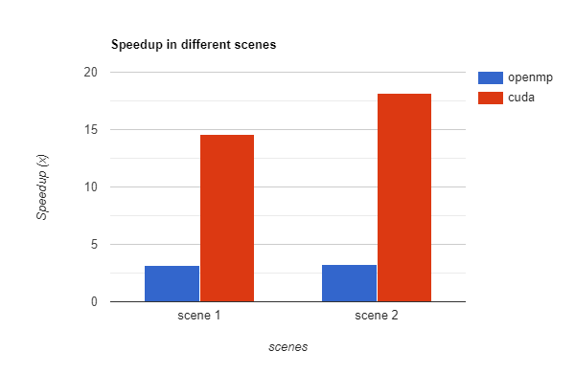
4. Different Scenes
view | 1 | - | 2 | -
- | Time | Speedup | Time | Speedup
serial | 70.72 | 1.0 | 71.51 | 1.0
multithreads | 22.17 | 3.19 | 21.77 | 3.28
cuda | 4.85 | 14.61 | 3.94 | 18.15
Notes:
表現在不同的 dataset 上都可以取得到相當程度的 speedup

Slide 55
Conclusion
Cuda has the best performance
More data (pixel, sample rate) makes GPU acceleration more significant
GPU speedup: why not as effective as hw5? (100x)
Notes:
主要是因為我們一個thread的工作比起作業來講更加複雜，
有更多的 branch condition
因爲每一個材質的反彈條件都不同，光線的反射行為也不同，會須要執行不同的程式，導致GPU會有更多stall，efficiency降低

Slide 56
THANKS!
Any questions?
PP is fun, YYPPP is even more fun
This is our YYPPP FP Presentation
-> YYPPP FP P
Parallelizing Path Tracing -> PPT
PowerPoint -> PPT
-> YYPPPFPPPPTPPT

